Slide 1
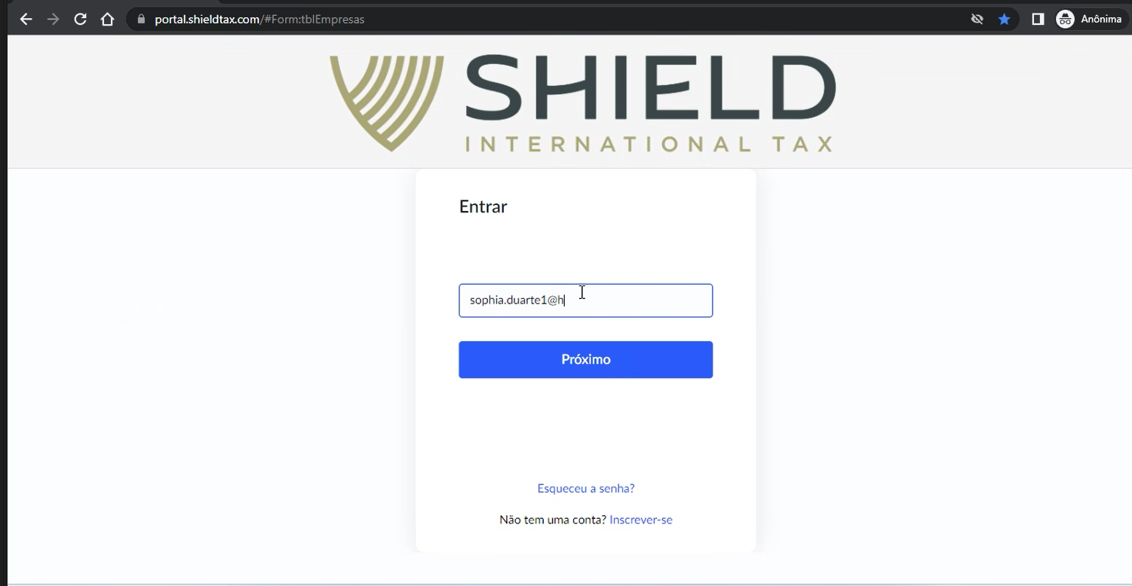
Login at Shield Portal
Each client has its own login and password

Slide 2
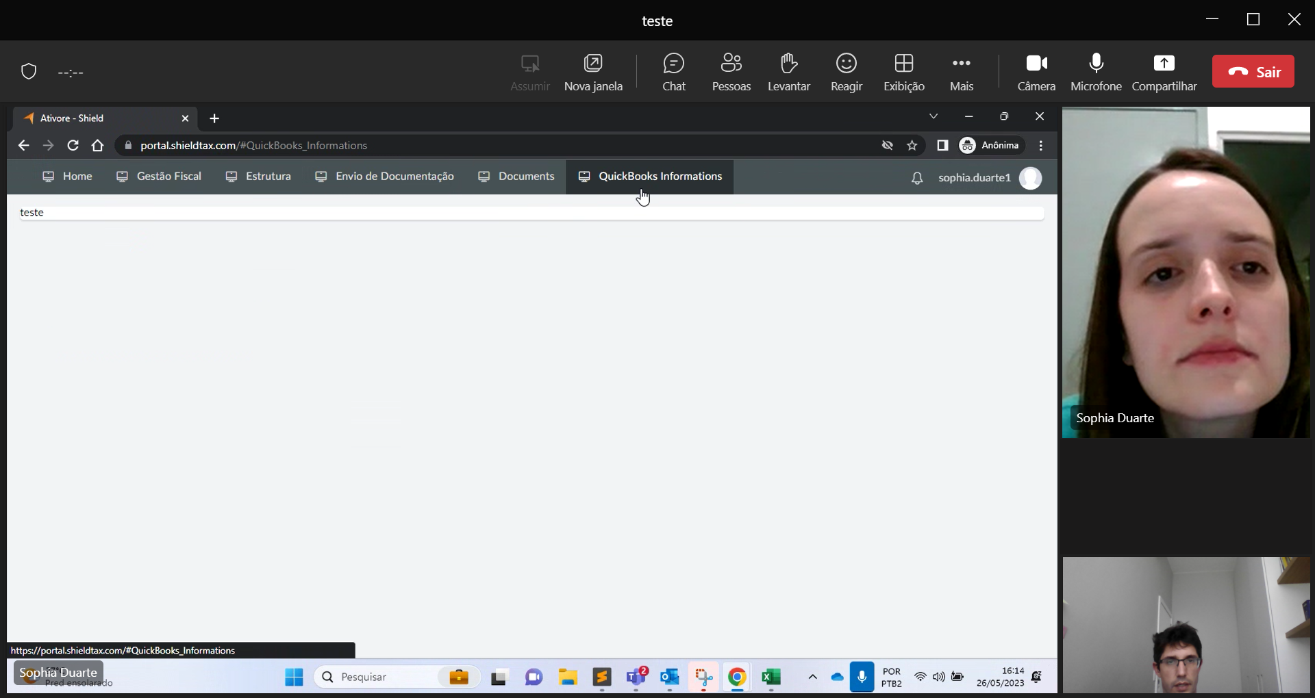
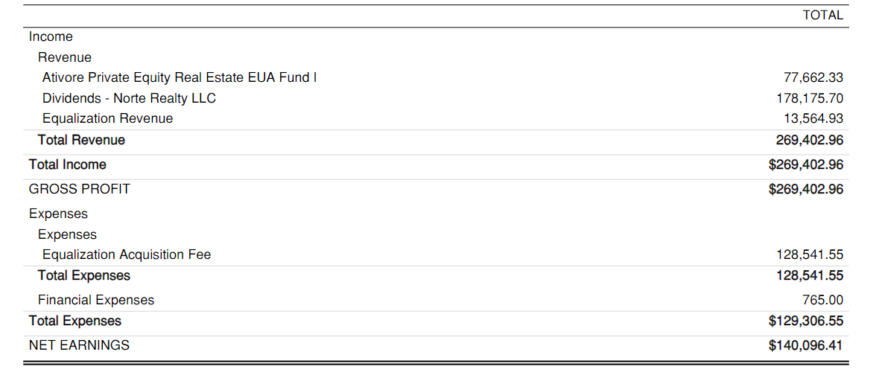
This is a new section!
When the user click at “Quickbook Information” the
Portal displays the P&L of
the company
The client could navigate through the center of revenues and cost

Slide 3
When the client clicks for example at “Ativore Private”
the portal displays a detailed table with all transactions;

Slide 4
When the client clicks for example at “Final Expensed”
the portal displays a detailed table with all transactions;

